Slide 1


COMPression algorithms
Andrei Toader

Slide 2

Run length encoding - RLE
It is based on the coding of repetitive sequences.
“Runs” are replaced with a tripled representing the repeated character, a repetition marker, and the repetition length.

Slide 3

SHANNON FANO
A top-down approach.
Sort symbols according to their frequencies.
e.g: ABCDE

Slide 4
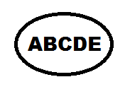

SHANNON FANO
Recursively divide into two parts, each with approximately same number of counts.
Find out k, where is minimum.

Slide 5
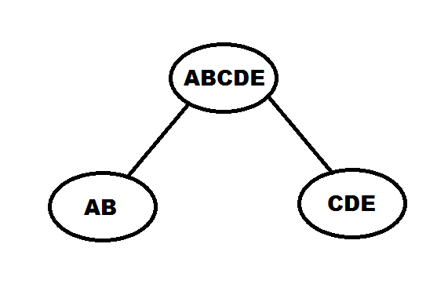
SHANNON FANO
S1 = {S[1], S[2], … S[k]}
S2 = {S[k+1], S[k+2], …, S[N]}
Shannon_Fano(S1);
Shannon_Fano(S2);

Slide 6
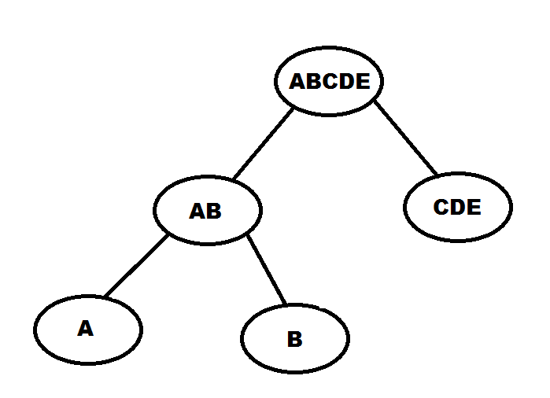
SHANNON FANO

Slide 7
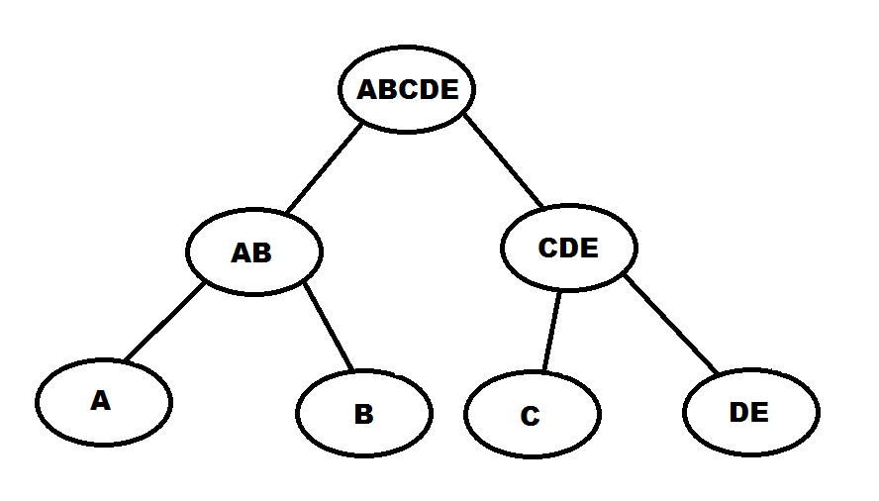
SHANNON FANO

Slide 8
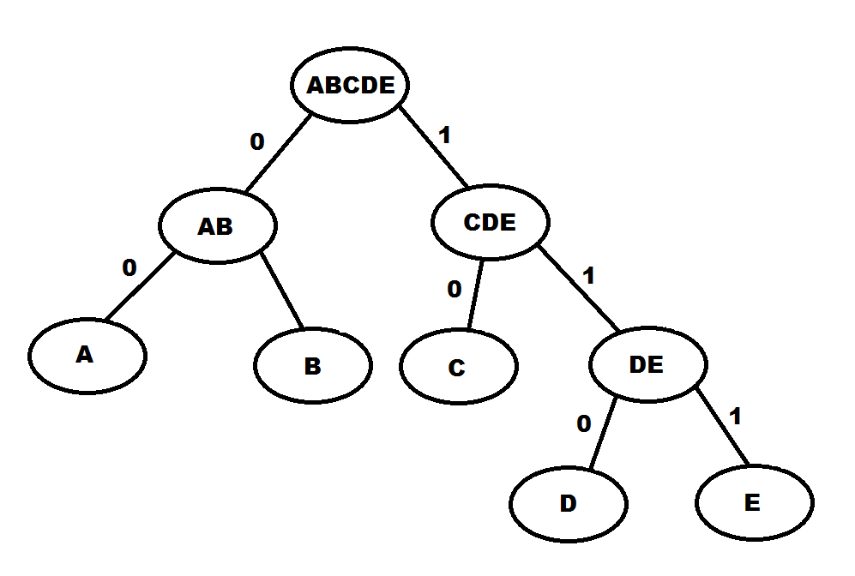
SHANNON FANO

Slide 9
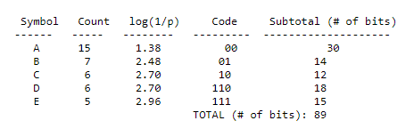
SHANNON FANO
Compressed number of bits = 89.

Slide 10
Huffman
Instead of top-down, the approach here is bottom-up.
Now, let’s create the Huffman Tree.

Slide 11
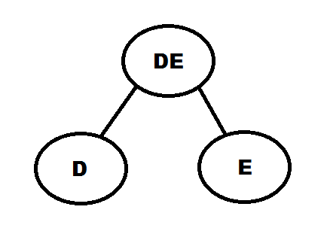
Huffman
Sort the list by frequency and make the two-lowest elements into leaves.
Then, create a parent node with a frequency that is the sum of the two.

Slide 12
Huffman
The two elements are removed from the list and the new node, with the sum of the frequency is inserted into the list. Of course, the list will be sorted again by frequency.
You then repeat the loop, combining the two lowest elements.

Slide 13
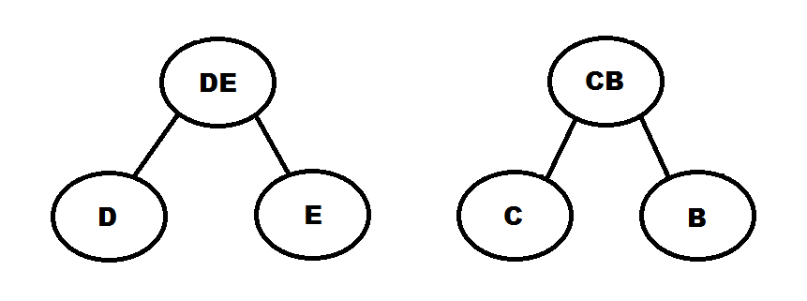
Huffman

Slide 14
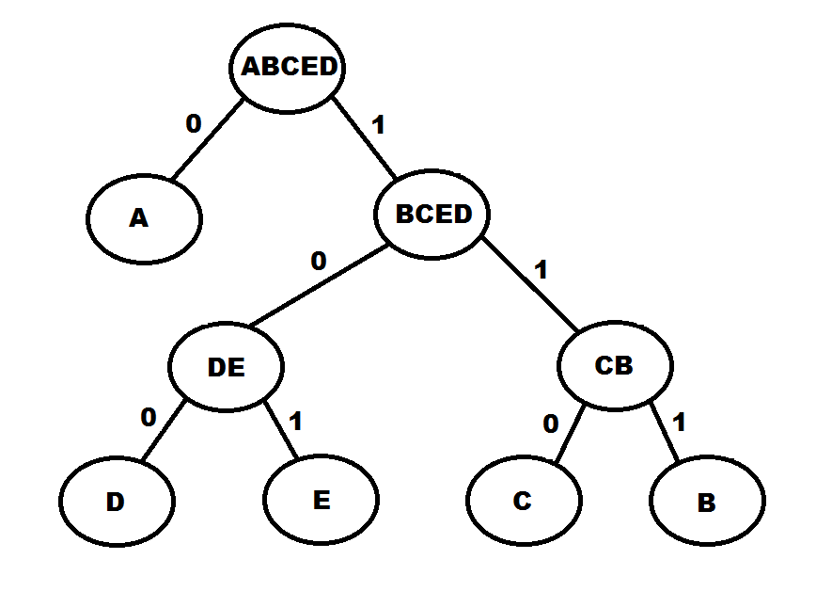
Huffman

Slide 15
Huffman
A = 1 bit
B, C, D, E = 3 bits
Total number of bits needed => 87 bits

Slide 16
References
https://users.cs.cf.ac.uk/Dave.Marshall/Multimedia/node206.html
http://webspace.ulbsibiu.ro/macarie.breazu/SF+HS.pdf
https://www.siggraph.org/education/materials/HyperGraph/video/mpeg/mpegfaq/huffman_tutorial.html

Slide 17
THANK YOU

